Slide 1
CHAPTER 10:
Hypothesis Testing, One Population Mean or Proportion
to accompany
Introduction to Business Statistics
seventh edition, by Ronald M. Weiers
Presentation by Priscilla Chaffe-Stengel
Donald N. Stengel
© 20011 Cengage Learning.
All Rights Reserved. May not be scanned, copied, or duplicated, or posted to a publicly accessible website, in whole or in part.

Slide 2
Chapter 10 - Learning Objectives
Describe the logic of and transform verbal statements into null and alternative hypotheses.
Describe what is meant by Type I and Type II errors.
Conduct a hypothesis test for a single population mean or proportion.
Determine and explain the p-value of a test statistic.
Explain the relationship between confidence intervals and hypothesis tests.
© 2011 Cengage Learning.
All Rights Reserved. May not be scanned, copied, or duplicated, or posted to a publicly accessible website, in whole or in part.

Slide 3
Null and Alternative Hypotheses
Null Hypotheses
  H₀: Put here what is typical of the population, a term that characterizes “business as usual” where nothing out of the ordinary occurs.
Alternative Hypotheses
  H₁: Put here what is the challenge, the view of some characteristic of the population that, if it were true, would trigger some new action, some change in procedures that had previously defined “business as usual.”
© 2011 Cengage Learning.
All Rights Reserved. May not be scanned, copied, or duplicated, or posted to a publicly accessible website, in whole or in part.

Slide 4
Beginning an Example
When a robot welder is in adjustment, its mean time to perform its task is 1.3250 minutes. Past experience has found the standard deviation of the cycle time to be 0.0396 minutes. An incorrect mean operating time can disrupt the efficiency of other activities along the production line. For a recent random sample of 80 jobs, the mean cycle time for the welder was 1.3229 minutes. Does the machine appear to be in need of adjustment?
© 2011 Cengage Learning.
All Rights Reserved. May not be scanned, copied, or duplicated, or posted to a publicly accessible website, in whole or in part.

Slide 5
Building Hypotheses
What decision is to be made?
  The robot welder is in adjustment.
  The robot welder is not in adjustment.
How will we decide?
  “In adjustment” means µ = 1.3250 minutes.
  “Not in adjustment” means µ ≠ 1.3250 minutes.
Which requires a change from business as usual? What triggers new action?
  Not in adjustment - H₁: µ ≠ 1.3250 minutes
© 2011 Cengage Learning.
All Rights Reserved. May not be scanned, copied, or duplicated, or posted to a publicly accessible website, in whole or in part.

Slide 6
Types of Error
State of Reality
H₀ True
H₀ False
Type II error:
β
Do not
Reject H₀
No error
Test
Says
Type I
error:
α
Reject H₀
No error
© 2011 Cengage Learning.
All Rights Reserved. May not be scanned, copied, or duplicated, or posted to a publicly accessible website, in whole or in part.

Slide 7
Types of Error
Type I Error:
  Saying you reject H₀ when it really is true.
  Rejecting a true H₀.
Type II Error:
  Saying you do not reject H₀ when it really is false.
  Failing to reject a false H₀.
© 2011 Cengage Learning.
All Rights Reserved. May not be scanned, copied, or duplicated, or posted to a publicly accessible website, in whole or in part.

Slide 8
Acceptable Error for the Example
Decision makers frequently use a 5% significance level.
  Use α = 0.05.
  An α-error means that we will decide to adjust the machine when it does not need adjustment.
  This means, in the case of the robot welder, if the machine is running properly, there is only a 0.05 probability of our making the mistake of concluding that the robot requires adjustment when it really does not.
© 2011 Cengage Learning.
All Rights Reserved. May not be scanned, copied, or duplicated, or posted to a publicly accessible website, in whole or in part.

Slide 9
The Null Hypothesis
Nondirectional, two-tail test:
  H₀: pop parameter = value
Directional, right-tail test:
  H₀: pop parameter ≤ value
Directional, left-tail test:
  H₀: pop parameter ≥ value
Always put hypotheses in terms of population parameters. H₀ always gets “=“.
© 2011 Cengage Learning.
All Rights Reserved. May not be scanned, copied, or duplicated, or posted to a publicly accessible website, in whole or in part.

Slide 10
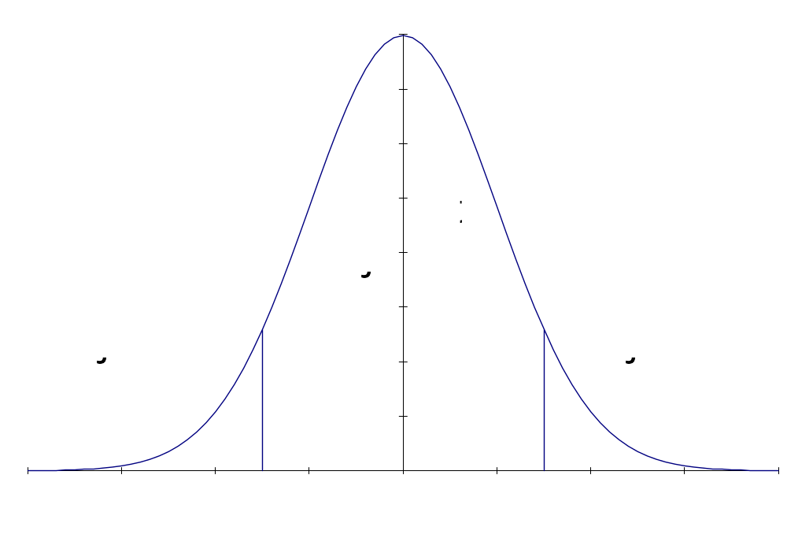
Nondirectional, Two-Tail Tests
  H₀: pop parameter = value
  H₁: pop parameter ≠ value
© 2011 Cengage Learning.
All Rights Reserved. May not be scanned, copied, or duplicated, or posted to a publicly accessible website, in whole or in part.

Slide 11
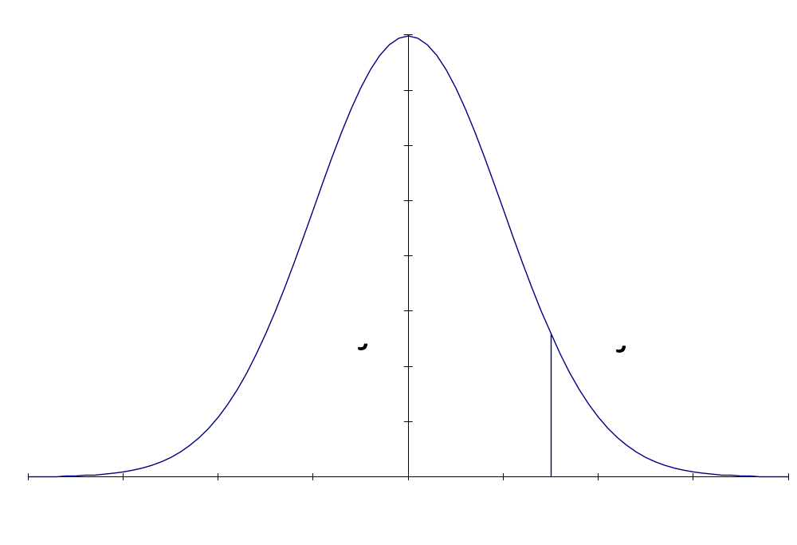
Directional, Right-Tail Tests
  H₀: pop parameter ≤ value
  H₁: pop parameter > value
© 2011 Cengage Learning.
All Rights Reserved. May not be scanned, copied, or duplicated, or posted to a publicly accessible website, in whole or in part.

Slide 12
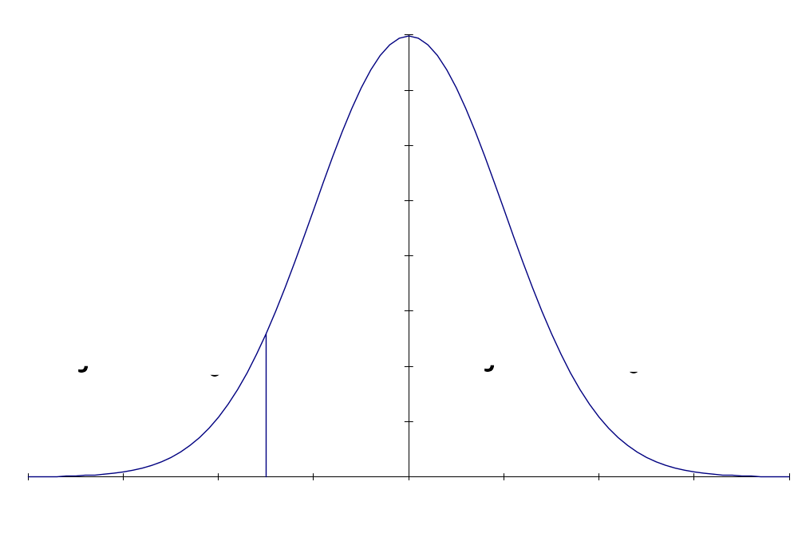
Directional, Left-Tail Tests
  H₀: pop parameter ≥ value
  H₁: pop parameter < value
© 2011 Cengage Learning.
All Rights Reserved. May not be scanned, copied, or duplicated, or posted to a publicly accessible website, in whole or in part.

Slide 13
The Logic of Hypothesis Testing
Step 1.
A claim is made.
A new claim is asserted that challenges existing thoughts about a population characteristic.
  Suggestion: Form the alternative hypothesis first, since it embodies the challenge, the reason you are doing the test.
© 2011 Cengage Learning.
All Rights Reserved. May not be scanned, copied, or duplicated, or posted to a publicly accessible website, in whole or in part.

Slide 14
The Logic of Hypothesis Testing
Step 2.
How much error are you willing to accept?
Select the maximum acceptable error, α. The decision maker must elect how much error he/she is willing to accept in making an inference about the population. The significance level of the test is the maximum probability that the null hypothesis will be rejected incorrectly, a Type I error.
© 2011 Cengage Learning.
All Rights Reserved. May not be scanned, copied, or duplicated, or posted to a publicly accessible website, in whole or in part.

Slide 15
The Logic of Hypothesis Testing
Step 3.
If the null hypothesis were true, what would you expect to see?
Assume the null hypothesis is true. This is a very powerful statement. The test is always referenced to the null hypothesis.
Form the rejection region, the areas in which the decision maker is willing to reject the presumption of the null hypothesis.
© 2011 Cengage Learning.
All Rights Reserved. May not be scanned, copied, or duplicated, or posted to a publicly accessible website, in whole or in part.

Slide 16
The Logic of Hypothesis Testing
Step 4.
What did you actually see?
Compute the sample statistic. The sample provides a set of data that serves as a window to the population. The decision maker computes the sample statistic and calculates how far the sample statistic differs from the presumed distribution that is established by the null hypothesis.
© 2011 Cengage Learning.
All Rights Reserved. May not be scanned, copied, or duplicated, or posted to a publicly accessible website, in whole or in part.

Slide 17
The Logic of Hypothesis Testing
Step 5.
Make the decision.
The decision is a conclusion supported by evidence. The decision maker will:
  reject the null hypothesis if the sample statistic falls in the rejection region, the sample evidence is so strong, the sample statistic so unlikely, that the decision maker is convinced H₁ must be true.
  fail to reject the null hypothesis if the sample statistic falls in the nonrejection region. In this case, the decision maker is not concluding the null hypothesis is true, only that there is insufficient evidence to dispute it based on this sample.
© 2011 Cengage Learning.
All Rights Reserved. May not be scanned, copied, or duplicated, or posted to a publicly accessible website, in whole or in part.

Slide 18
The Logic of Hypothesis Testing
Step 6.
What are the implications of the decision for future actions?
State what the decision means in terms of the business situation.
The decision maker must draw out the implications of the decision. Is there some action triggered, some change implied? What recommendations might be extended for future attempts to test similar hypotheses?
© 2011 Cengage Learning.
All Rights Reserved. May not be scanned, copied, or duplicated, or posted to a publicly accessible website, in whole or in part.

Slide 19
Hypotheses for the Example
The hypotheses are:
  H₀: µ = 1.3250 minutes
  The robot welder is in adjustment.
  H₁: µ ≠ 1.3250 minutes
  The robot welder is not in adjustment.
This is a nondirectional, two-tail test.
© 2011 Cengage Learning.
All Rights Reserved. May not be scanned, copied, or duplicated, or posted to a publicly accessible website, in whole or in part.

Slide 20
Identifying the Appropriate Test Statistic
Ask the following questions:
Are the data the result of a measurement (a continuous variable) or a count (a discrete variable)?
Is σ known?
What shape is the distribution of the population parameter?
What is the sample size?
© 2011 Cengage Learning.
All Rights Reserved. May not be scanned, copied, or duplicated, or posted to a publicly accessible website, in whole or in part.

Slide 21
Continuous Variables
Continuous data are the result of a measurement process. Each element of the data set is a measurement representing one sampled individual element.
  Test of a mean, µ
    Example: When a robot welder is in adjustment, its mean time to perform its task is 1.3250 minutes. For a recent sample of 80 jobs, the mean cycle time for the welder was 1.3229 minutes.
    Note that time to complete each of the 80 jobs was measured. The sample average was computed.
© 2011 Cengage Learning.
All Rights Reserved. May not be scanned, copied, or duplicated, or posted to a publicly accessible website, in whole or in part.

Slide 22

Test of µ, σ Known, Population Normally Distributed
Test Statistic:
  where
    is the sample statistic.
    µ₀ is the value identified in the null hypothesis.
    σ is known.
    n is the sample size.
x
–
μ
z
=
0
σ
n
© 2011 Cengage Learning.
All Rights Reserved. May not be scanned, copied, or duplicated, or posted to a publicly accessible website, in whole or in part.

Slide 23
Test of µ, σ Known, Population Shape Not Known/Not Normal
If n ≥ 30, Test Statistic:
If n < 30, use a distribution-free test (see Chapter 14).
x
–
μ
z
=
0
σ
n
© 2011 Cengage Learning.
All Rights Reserved. May not be scanned, copied, or duplicated, or posted to a publicly accessible website, in whole or in part.

Slide 24
Test of µ, σ Unknown, Population Normally Distributed
Test Statistic:
  where
    is the sample statistic.
    µ₀ is the value identified in the null hypothesis.
    σ is unknown.
    n is the sample size
    degrees of freedom on t are n – 1.
x
–
μ
t
=
0
s
n
x
© 2011 Cengage Learning.
All Rights Reserved. May not be scanned, copied, or duplicated, or posted to a publicly accessible website, in whole or in part.

Slide 25
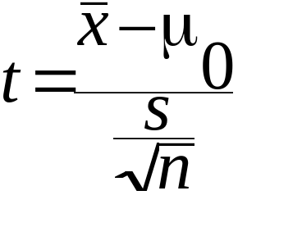
Test of µ, σ Unknown, Population Shape Not Known/Not Normal
If n ≥ 30, Test Statistic:
If n < 30, use a distribution-free test (see Chapter 14).
© 2011 Cengage Learning.
All Rights Reserved. May not be scanned, copied, or duplicated, or posted to a publicly accessible website, in whole or in part.

Slide 26
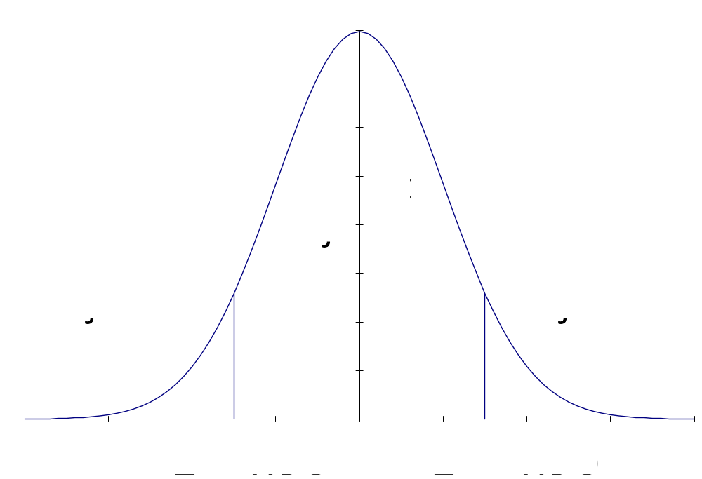
The Formal Hypothesis Test for the Example, σ Known
I. Hypotheses
  H₀: µ = 1.3250 minutes
  H₁: µ ≠ 1.3250 minutes
II. Rejection Region
  α = 0.05
  Decision Rule:
  If z < – 1.96 or z > 1.96,
  reject H₀.
© 2011 Cengage Learning.
All Rights Reserved. May not be scanned, copied, or duplicated, or posted to a publicly accessible website, in whole or in part.

Slide 27
The Formal Hypothesis Test, cont.
III. Test Statistic: Given a sample of 80 jobs with a sample mean of 1.3229 minutes,
IV. Conclusion
Since the test statistic of z = – 0.47 fell between the critical boundaries of z = ± 1.96, we do not reject H₀ with at least
95% confidence or at most 5% error.
x
–
μ
z
=
0
=
1
.
3229
–
1
.
3250
=
–
0
.
0021
=
–
0
.
47
σ
0
.
0396
0
.
00443
n
80
© 2011 Cengage Learning.
All Rights Reserved. May not be scanned, copied, or duplicated, or posted to a publicly accessible website, in whole or in part.

Slide 28
The Formal Hypothesis Test, cont.
V. Implications
This is not sufficient evidence to conclude that the robot welder is out of adjustment.
© 2011 Cengage Learning.
All Rights Reserved. May not be scanned, copied, or duplicated, or posted to a publicly accessible website, in whole or in part.

Slide 29
Discrete Variables
Discrete data are the result of a counting process. The sampled elements are sorted, and the elements with the characteristic of interest are counted.
  Test of a proportion, π
    Example: The career services director of Hobart University has said that 70% of the school’s seniors enter the job market in a position directly related to their undergraduate field of study. In a sample of 200 of last year’s graduates, 132 or 66% have entered jobs related to their field of study.
© 2011 Cengage Learning.
All Rights Reserved. May not be scanned, copied, or duplicated, or posted to a publicly accessible website, in whole or in part.

Slide 30
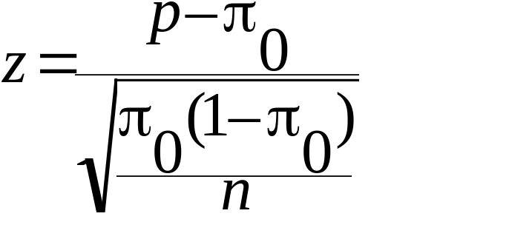
Test of π, Sample Sufficiently Large
If both n π ≥ 5 and n(1 – π) ≥ 5,
Test Statistic:
  where p = sample proportion
  π₀ is the value identified in the null hypothesis.
  n is the sample size.
© 2011 Cengage Learning.
All Rights Reserved. May not be scanned, copied, or duplicated, or posted to a publicly accessible website, in whole or in part.

Slide 31
Test of π, Sample Not Sufficiently Large
If either n π < 5 or n(1 – π) < 5, convert the proportion to the underlying binomial distribution.
Note there is no t-test on a population proportion.
© 2011 Cengage Learning.
All Rights Reserved. May not be scanned, copied, or duplicated, or posted to a publicly accessible website, in whole or in part.

Slide 32
Observed Significance Level
A p-value is:
  the exact level of significance of the test statistic.
  the smallest value α can be and still allow us to reject the null hypothesis.
  the amount of area left in the tail beyond the test statistic for a one-tailed hypothesis test or
  twice the amount of area left in the tail beyond the test statistic for a two-tailed test.
  the probability of getting a test statistic from another sample that is at least as far from the hypothesized mean as this sample statistic is.
© 2011 Cengage Learning.
All Rights Reserved. May not be scanned, copied, or duplicated, or posted to a publicly accessible website, in whole or in part.

